Slide 1
Employee Data Analysis using Excel
STUDENT NAME: SURAJ R
REGISTER NO: 122200921, AD778DECC6CF7EB2214E7C59F4146ED
DEPARTMENT: BACHELOR OF COMMERCE
(CORPORATE SECRETARYSHIP)
COLLEGE: K.C.S. KASI NADAR COLLEGE OF ARTS & SCIENCE

Slide 2
PROJECT TITLE
Employees Project Completion Analysis Using Excel​

Slide 3

AGENDA
Problem Statement
Project Overview
End Users
Our Solution and Proposition
Dataset Description
Modelling Approach
Results and Discussion
Conclusion
3/21/2024 Annual Review

Slide 4

PROBLEM STATEMENT
The feedback of work of the HR managers are analysed by using various formulas in excel.this helps the company administration to get results in,
Improved Performance
Enhanced Skills
Increased Job Satisfaction
Better Decision-Making
Effective Communication
Alignment with Organizational Goals

Slide 5

PROJECT OVERVIEW
By this project the company can deeply analyse the number of HR managers in the company in different departments, their projects and how long they are being working in the company. And also we can see the feedback of the HR workforce according to their designation. This help the organisation to improve, implement the goals of the company.
.

Slide 6

WHO ARE THE END USERS?
HR Managers
Employees
Senior Management
Training and Development Teams
External Stakeholders
Recruitment Teams
Organizational Development Professionals
Legal and Compliance Teams

Slide 7
OUR SOLUTION AND IT'S VALUE PROPOSITION
The employees dataset that we prepare by using various formulas and tools of Excel like alignment, removing duplicates, filtering, conditional formatting, pivot table, graph and If formula shows the dataset clearly.
By this we can clearly understand datas given in the excel sheet.and also this help the an organisation take better decision on implementing various goals and get relevent information about the HR managers.
The graph that helps to visualise the data properly.
So our project on HR managers feedback analysis provided perfect solution that a organisation expect.

Slide 8
DATASET DESCRIPTION
In this dataset we can find the relevent information of the HR managers who are working in the different departments of the company.
The name,age, employee I'd, department,project done , joining date,salary, designation,gender project completed and feedback status and the score are provided to the each and every HR managers of the company.
This dataset description can be seen in the project.

Slide 9
THE "WOW" IN OUR SOLUTION
Relevent information about the employees
Perfect feedback status and the score
Clear graph visualisation
3/21/2024 Annual Review
9

Slide 10
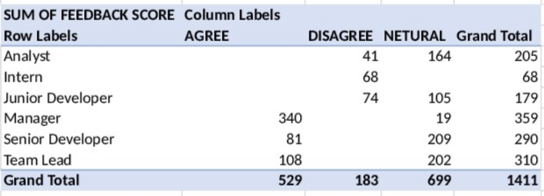
MODELLNG
Step1 : Downloaded dataset from kaggle website
Step2 : Extracted from zip format
Step3 : Using alignment in Excel for clear and presentable
Step4 : Changing the size of rows & Columns of the given data
Step5 : Identified and Removed Duplicate records
Step6 : Highlighting certain values using Conditional Formatting
Step7 : Using ifs formula for cleaner and more organized way to manage multiple conditional
checks.
Step8 : Adding Pivot Tables For quickly summarize large datasets.
Step9 : Using graphs to making it easier for understand and interpret complex information
10

Slide 11
RESULTS
Row Labels | Sum of PROJECT COMPLETED | Sum of FEEDBACK SCORE
Finance | 247 | 310
HR | 155 | 203
IT | 254 | 311
Marketing | 190 | 244
Sales | 268 | 343
Grand Total | 1114 | 1411
11

Slide 12
Conclusion
In conclusion, the employee dataset has equipped us with actionable insights that will inform strategic decisions and improve HR practices. By leveraging this data, we can enhance workforce management, drive organizational growth, and create a more supportive and productive work environment.

